Slide 1
Predicting the type of airport to construct
Taehyun Yoon

Slide 2
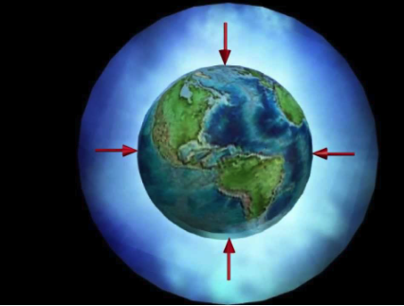


The effect of altitude and flying
Density altitude is a measure of how 'thick' the air is, and it's based on three factors:
Atmospheric pressure
Temperature
Humidity.
When the plane flies, if one of these factors does not match with the type of plane, it would cause a BIG PROBLEM.

Slide 3
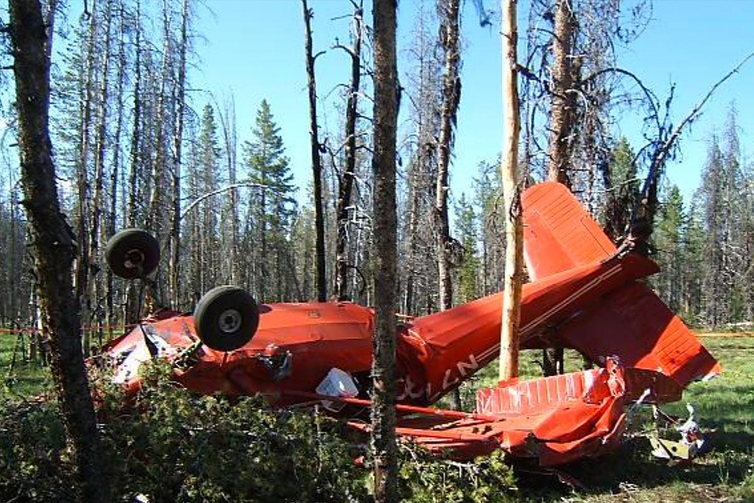
The problem
Frequent plane crash.
Some crashes are related to
altitude problems.
Incident example,
On June 30th, 2012 a pilot flying a Stinson 108 crashed shortly after takeoff from the Bruce Meadow's Airport (U63), Idaho which is off from the 5,000 foot turf/dirt airstrip with a field elevation of 6,370 feet MSL.
The pilot miscalculated that the density altitude was about 9,200 feet.
Hence,
Density altitude is important to know.

Slide 4





Who cares?
Pilots, anybody who’s thinking to work in this field.
Flight engineers, aerospace engineers
Airlines
And a lot more..

Slide 5
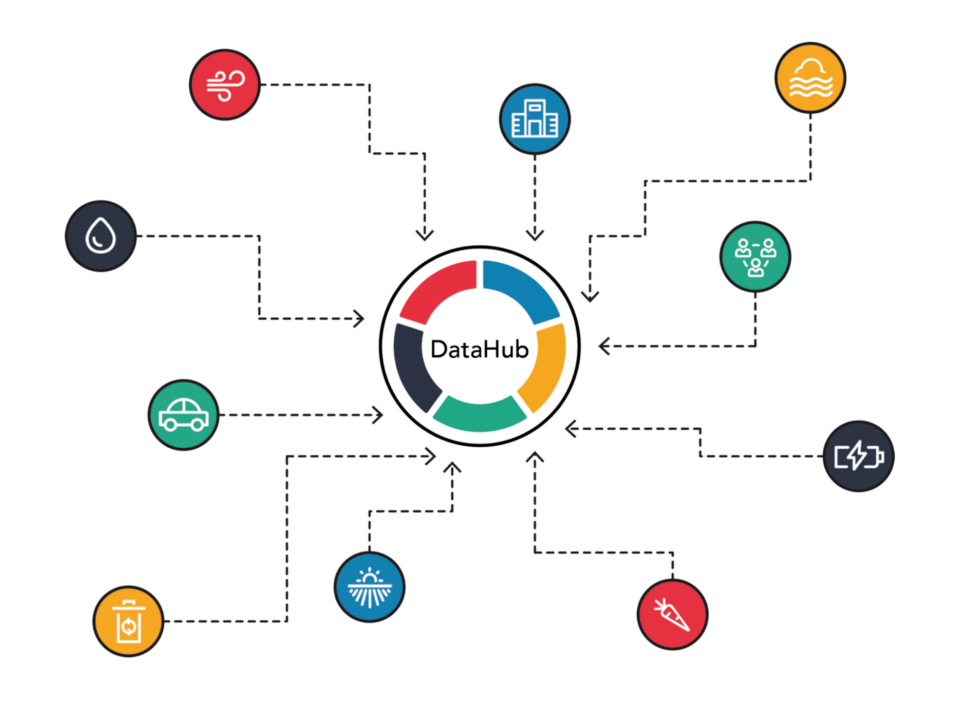
Data Information
Source: DataHub
Data Created: 2018
Last updated: 2020
Number of Records: 57421
Number of Fields: 12
File format: CSV

Slide 6
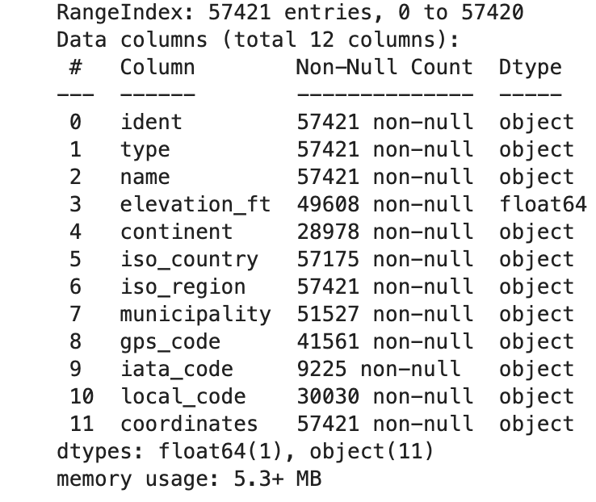
Feature Information
Columns that are primary key values
Ident
Name
Municipality
Gps_code
Iata_code
Local_code
Target feature
Type
Key features
Elevation_ft
Continent

Slide 7
Data Wrangling
Link:
https://github.com/taehyun53/Airport_code/blob/main/notebooks/datawrangling.ipynb
Cleaned the data into useful components.
Detected outliers
Box plot
Combined features for adequate analysis
Detected patterns for missing values for all the features using msno.matrix.

Slide 8
Why MSNO Matrix?
Machine learning algorithms:
Bad at missing data and require entire rows
where a single missing value is present
So we use MSNO matrix!
Advantages
identify where missing values occur, the extent of the missingness and whether any of the missing values are correlated with each other.

Slide 9
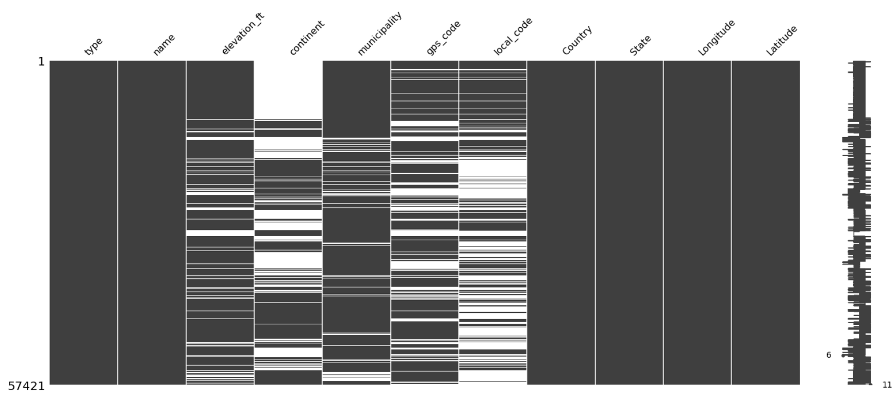
Missing with no pattern!

Slide 10
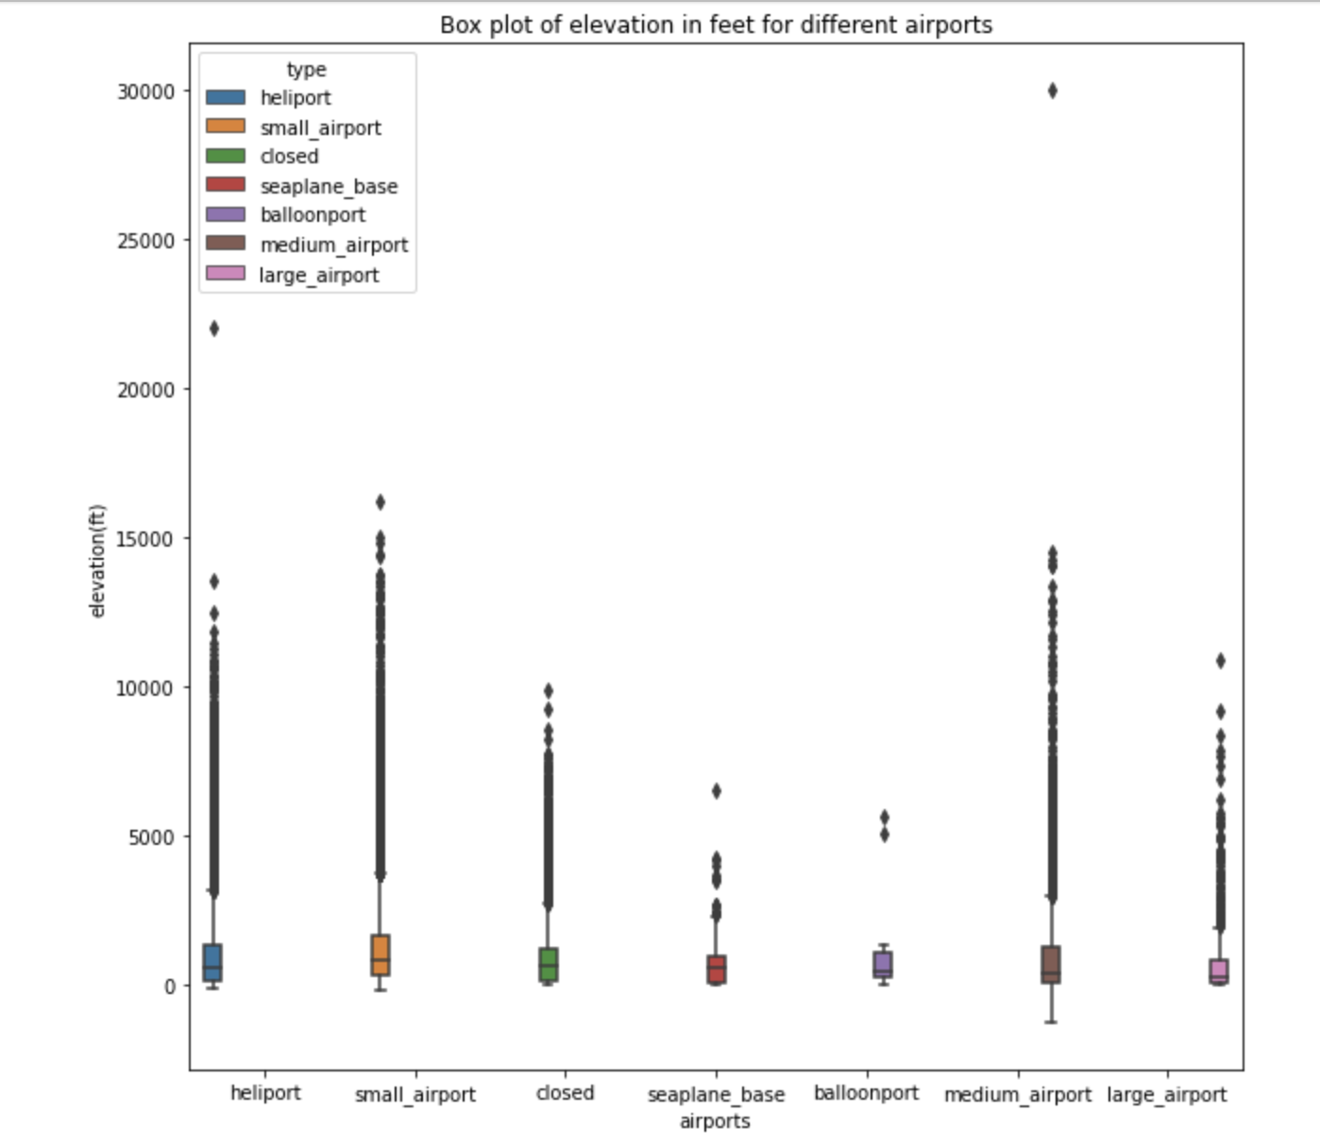
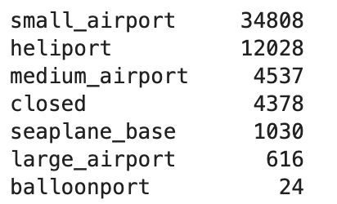
• Detected outliers
• Confirmed correct/incorrect outliers.
• Merged airports based on their similar features.
• Large airports -> seaplane base
• Balloon port -> medium airport

Slide 11
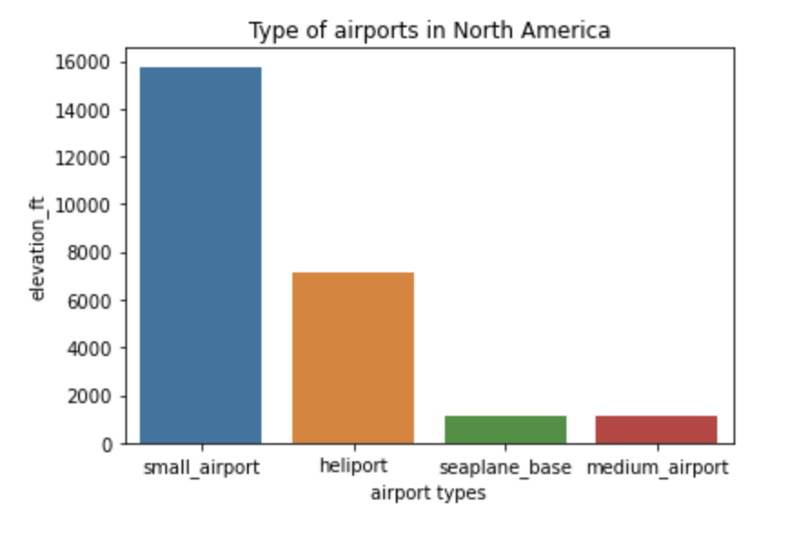
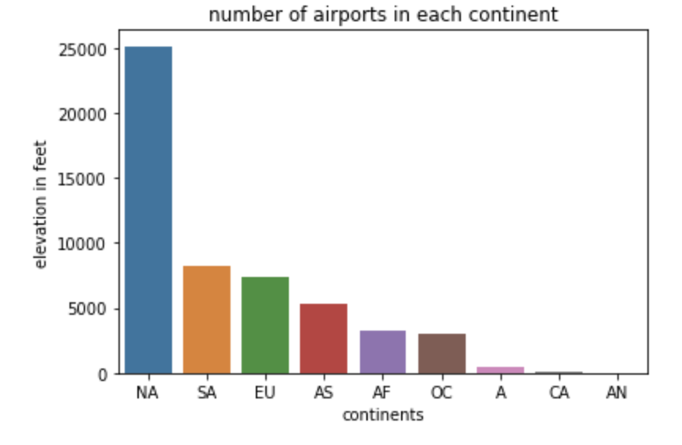
Exploratory Data Analysis: Why North America?
24.71 million km^2
High investment in Plane
Low train transportation
Notes:
North America is 6.86df million km^2 bigger than South America. They have low investments in train which made a lot of private, public airports for people to travel. The second rank is South America in terms of number of airports. North America has 6.86 million km^2 wider land than South America. The quantity 6.86 million means there are 60 South Korea land size in North America. That crazy big.North America has

Slide 12
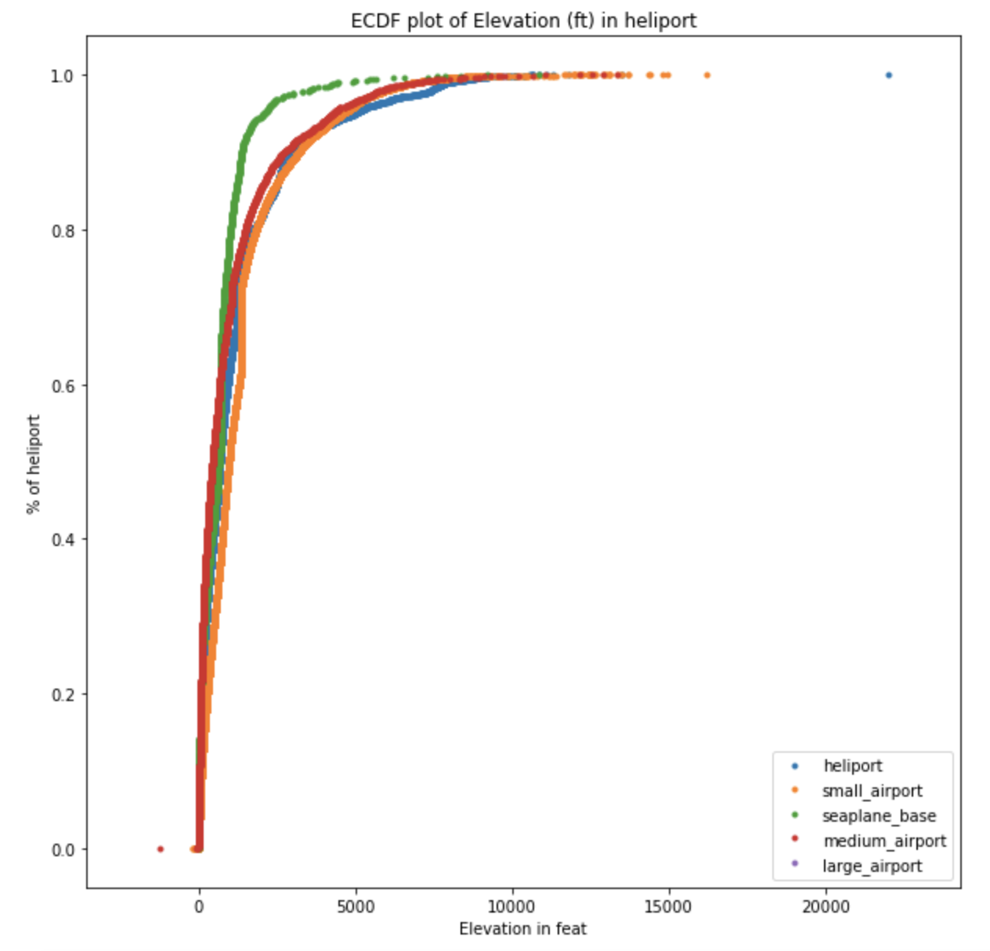
ECDF & Correlation
Mostly under 10000 feet.
Heliport - largest outlier.
Small airport and heliport has overlapping
Heliport is a airport for helicopters so it makes sense to have frequent, big outliers.

Slide 13
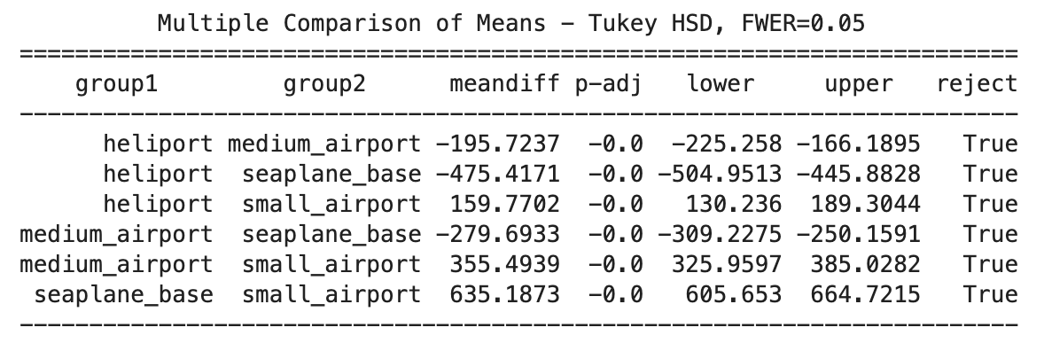
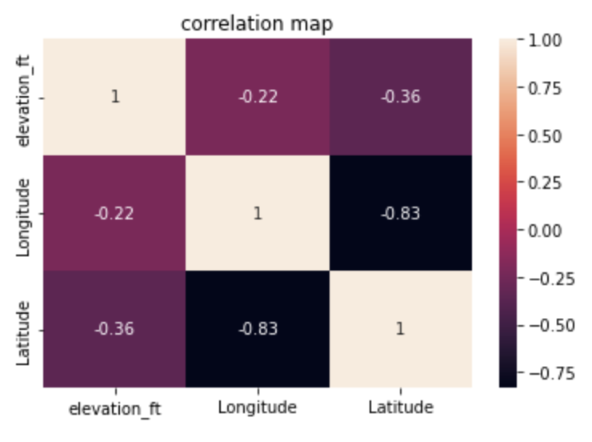
Are the mean value for all the airports separate? Or related?
Statistical difference:
1. Assume no difference between mean
Conclusion:
Shows significant statistical difference between ALL the groups
Correlation:
Yes, correlation.
So drop Longitude or Latitude!

Slide 14
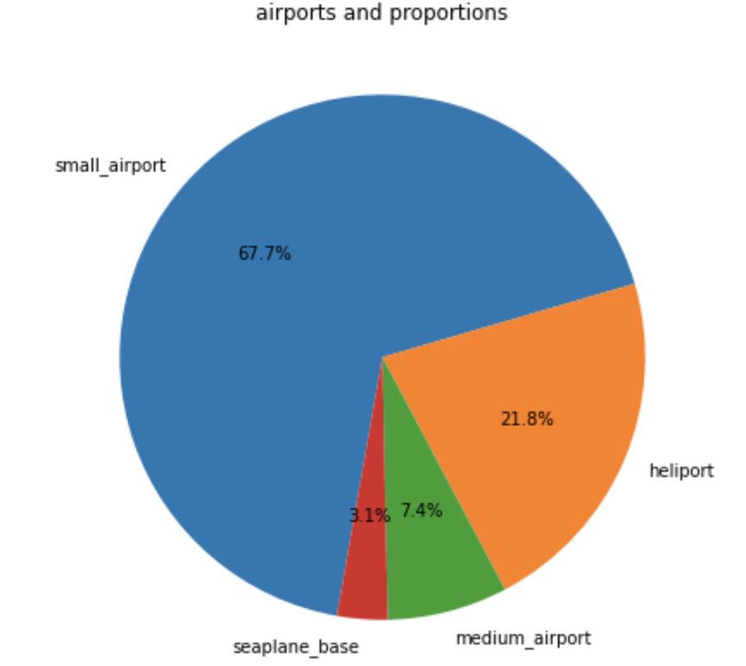
Modeling Overview
Type: Supervised Learning
Highly Imbalanced Data
Tools: Optuna, Sklearn, lightgbm, yellowbrick, category_encoders
Multi-Class Classification

Slide 15
Modeling Steps
Data pre-processing
Limiting your Columns
There are way too less values for A,CA,AN.
Make mask these as label ‘other’
Split data -> dependent & independent values.
Train(0.8), test(0.1), validation split data (0.1)
Encode categorical features
Scaling - Standard Scaler
Data Modeling & Hyperparameter Tuning
Model Compare & Evaluation

Slide 16

Scaling/Encoding/Resampling/Weighting Techniques Used
Why ensemble method?
Performance
Robustness
Performs very well on medium, small, data with subgroups and structured datasets with not too many features.
Bayesian Optimization
Faster than GridSearchCV
Standard Scaler
Makes it normally distributed
Mean = 0
Stdev = 1
Classification Algorithm Used
Light GBM
2. Ada Boost
3. Cat Boost

Slide 17
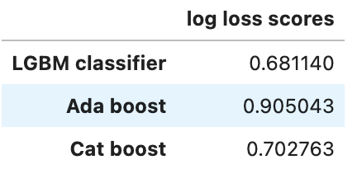
ROC
Sensitive to Imbalanced Classes
Log Loss
Robust in the presence of imbalanced classes
a lower log loss value means better predictions
LGBM is the best model.
Speed:
1. Catboost
2. LGBM classifier
3. Ada Boost

Slide 18
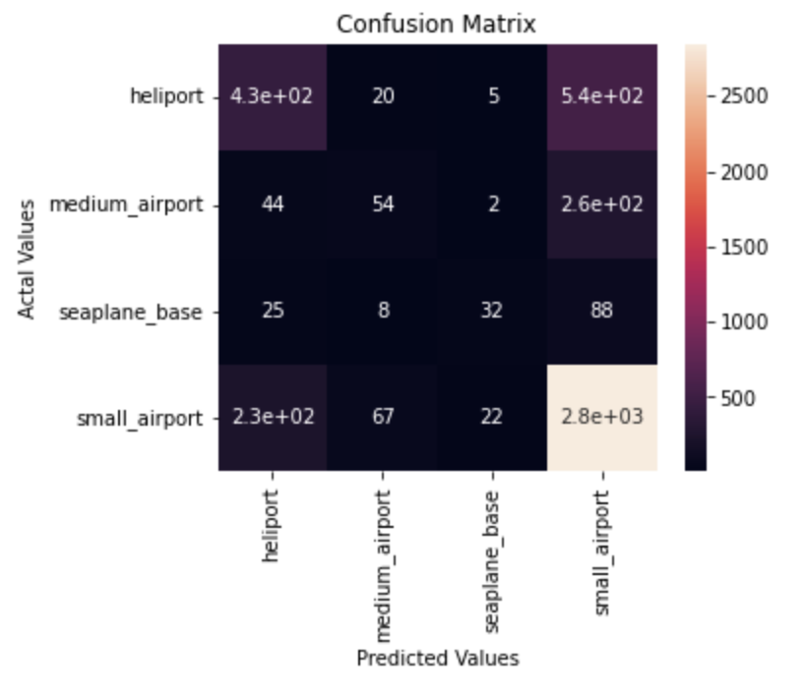
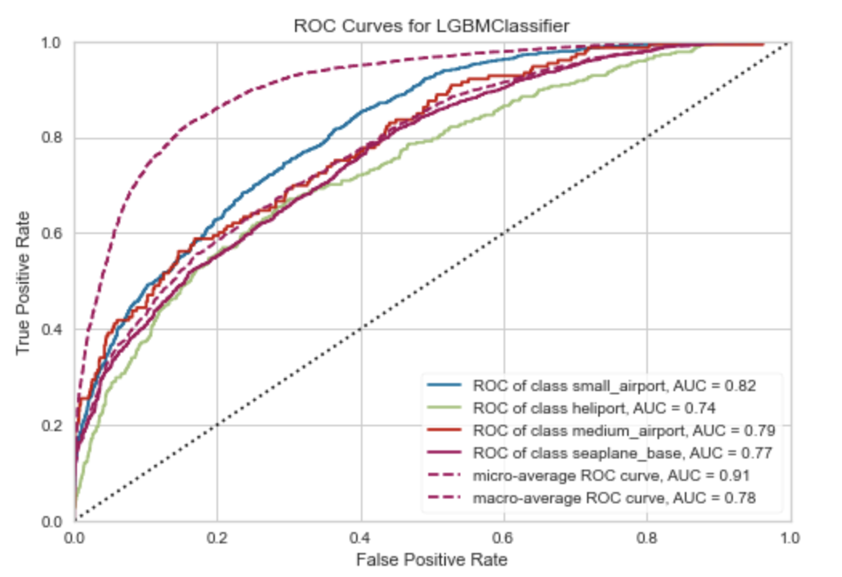
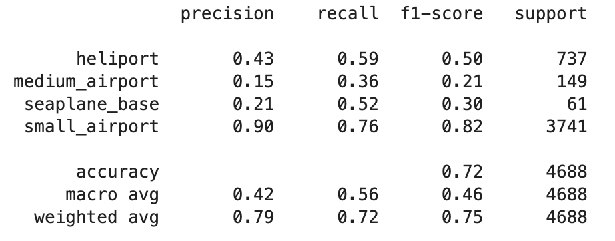
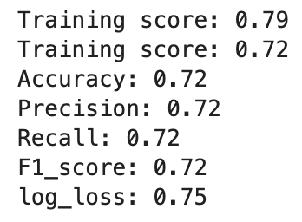
Model Evaluation & Metrics

Slide 19
More Ideas to Improve the Model in the future
Engineer more features related with altitude and elevation such as length of runways, airport capacity, airport infrastructure, etc
Add more parameters and try out more varieties such as the area, width, and height of each type of planes.

Slide 20
Conclusions
All sources of datasets contributed to the predictive power of the model
Out of 3 supervised classification models, the LGBM provided the best results.
Out of 67 features, we used only 31 features for the best model with 12 from the flight data, 16 from the weather data and 3 from the flight historical performances data (which we engineered).
Train Set - 80%, Test Set - 10%, Validation Set - 10%
With more features, the model can be improved in the future.
Log loss would be a good lose metric to use because it’s robust to imbalance datasets.

Slide 21

Taehyun Yoon
Email: t469349@gmail.com
Linkedin:www.linkedin.com/in/tyoon2773
GitHub: https://github.com/taehyun53
Project Report: https://github.com/taehyun53/Airport_code/tree/main/notebooks

